Slide 1
6MMCS002W Digital Marketing, Social Media and Web Analytics
Week 11 – Email Marketing
Dr Vassiliki Bouki and M. Margeti
boukiv@wmin.ac.uk

Slide 2
E-mail Marketing: what we’ll discuss
Email marketing: why, when and how
Types of emails: Newsletters, Promotion, Invitation to events, Announcements
Email design:
Consistent branding
Layout elements
Attracting attention
Links: external – internal – graphical
Top left corner
Email content:
Valuable Offers
Call-To-Action (CTA)
Social media aspects
‘From’ and ‘Subject’ lines
Output of e-mail campaign: bounced and blocked emails, evaluation of click-through data
Final remarks: Avoiding spam, Asking permission, Collecting email addresses

Slide 3
Email Marketing
Why?
It builds relationships for your customer in an affordable way
High return on investment (ROI). In other words, it generates lots of sales for a relatively small investment of money and time.
It is a familiar way to communicate with customers
When
Educate people about features and benefits of products or services
Differentiate yourself from the competition
Inform about a sale of a product or service
Strengthen customer relationships
Increase customer loyalty and referrals
Send thank you emails
Offer special privileges

Slide 4
Email Marketing
How – What is needed:
An authoring technology to create the content of emails in HTML and inline CSS.
A delivery technology that has the ability to send the emails to a large email list.
An email marketing provider (software) offers the above tools and also the email server. A provider has also tools for:
Tracking the recipient’s actions and creating tracking reports
Managing your email lists
Segmenting your email list based on recipients’ activity, demographics etc.
Arranging email automation
Sending campaign to a social network websites
Adding a QR coupon in an email for a specific campaign
A/B testing for subject lines, from lines, call to action etc.
Testing email, before sending it, in different browsers and mobile devices
Notes:
Segmentation is about sending relevant emails to your subscribers according to their needs, preferences, activities and demographics
It helps to send to your customers or subscribers content they are interested in

Slide 5
Email Marketing
How?
Common process used by email marketing provider software:
Create email list (add manually or import email addresses of subscribers)
Create a campaign
Craft the email message itself:
using your own code in HTML and inline CSS
using templates from email marketing provider
Assign email to the campaign
Connect email list and campaign and send it
Example of email marketing provider tools: Mail chimp
See what tools an email marketing provider software can offer in: http://kb.mailchimp.com/
BACK
Notes:
See how to do this with email marketing provider software mail chimp:
http://kb.mailchimp.com/getting-started/getting-started-with-mailchimp#Create-a-List
http://kb.mailchimp.com/campaigns
http://kb.mailchimp.com/lists/segments/getting-started-with-segments

Slide 6
Types of e-mail
Different type of email require different type of content and layout
Newsletters:
It is more about information, company’s news, rather than promotion
It can have columns to resemble a paper newsletter
You have to have enough content to compile a regular newsletter
It is a good format for sending different pieces of information which are not necessarily related (e.g. university news)
It is sent periodically (e.g. weekly or monthly)
It is not necessarily date driven like ‘promotion’ or ‘event’ emails
It should not contain too much promotional content
It should be no more than 20% of content in newsletter). If there is more than that then use promotional email
It is good for customer retention and brand awareness
Target: Inform (but a further action may be required: “Further news”)
Notes:
It is important to understand what type of email is suitable for each customer in our email list (you have to consider customer needs, preferences, history of purchases, location etc.
Examples of typical newsletters: NetMums, BCS

Slide 7
Types of e-mail
Promotion:
Focus is on:
a single product
a group of related products (such as a catalogue)
a theme, such as a sale or a specific celebration e.g Easter
They are sent because of a previous purchase (e.g. amazon), a previous inquiry or, they are date-driven (e.g. winter sale, Easter’s celebration)
Do not display all information about promotions (keep the rest for the website so you can see who is really interested for more information.)
Target: Get them to buy
Notes:
Amazon emails are good promotion examples in terms of segmentation and multiple or single offers

Slide 8
Types of e-mail
Invitations to events:
They focus on one or more events
They are date-driven
Send a series of similar email formats to get a good response
Plan them in a calendar to avoid over-communicating
Target: Get them to come to event
Announcement:
The focus is on relationship building rather than generating sales or leads
Examples: greetings, thank you messages, press releases, order confirmation, subscription confirmation
Target: Simply inform them, no specific action is required (which is nice from the client’s perspective not to be asked to do something)
BACK

Slide 9
E-mail design
Consistent Branding
Design of email should match design of your website
Include your logo
Use consistent colors and font style
Use consistent image types
Design between types of emails belonging to the same brand should be consistent
They should look similar but not identical
So, people recognize the brand but also realize that each type of email has a different purpose (it requires from them to do different things).
Notes:
Check guidelines in:
https://mailchimp.com/resources/email-design-guide/
Check good examples in terms of ‘consistent branding’ in the emails of companies such as:
-White Company
-Fortmum and Mason
-John Lewis
-Royal Opera/National Theatre

Slide 10
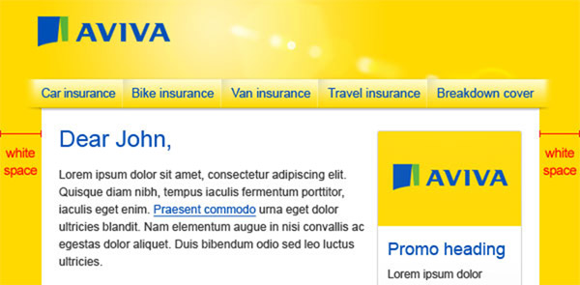
E-mail design
Layout Elements
Pre-header:
It can contain:
information about the email
text links ‘view in browser’ and ‘go to mobile site’
recommendation to add the email address to customer’s address book (good anti-spam technique)
Header (or Masthead):
It must contain: Logo of company
It may contain: navigation links, CTA, etc. (see slide about ‘top-left corner’)
Body:
It contains the main message of your email
Notes:
Check the Layout Elements of emails from: Fortnum and Mason, John Lewis, and BCS
Check more practical information in: http://kb.mailchimp.com/campaigns/design/view-and-edit-section-design

Slide 11
E-mail design
Layout Elements
Sidebar:
It can contain secondary information
It is usually found in a ‘newsletter’ type of email
Footer:
It contains information required by the law!
information about company (e.g. address of company’s premises, domain name of website, company’s registration number)
declarations about products and prices
‘unsubscribe’ link
reminder about customer joined the email list.

Slide 12
E-mail design
Attracting Attention
Elements that drive people’s attention when they scan an email:
Images/Icons/Graphics
Headlines
Links /Call to action
Dividing lines/borders
Background colours / Whitespace
Attributes of these elements which augment attention:
Colour
Size
Position
Top-left attracts more attention
Avoid placing elements that attracts too much attention in all four corners of email. It is more difficult for the users to scan it and decide what is the most important element.

Slide 13
E-mail design
Attracting Attention
Presentation and amount of main content:
Columns
It is easier to scan and organise content
Two columns either of equal width, left one narrower or right one narrower
Amount of information
Avoid too busy emails with too much information
If there is too much content for two columns, then consider sending multiple shorter emails and with higher frequency.
Include links which lead to website for more information
Notes:
Two columns of columns with equal width so you can avoid emphasising the content on one column over the other.
Two columns where the left one has narrower width to emphasise the content to the right wider column
Two columns where the right one has narrower width to emphasise the content in the wider left column

Slide 14
E-mail design
Links
External links:
Links opening a different browser window that can be a page of website (call-to-action(CTA), logo)
Links opening videos and files
External links help to avoid too busy emails and also they serve tracking purposes, as clicking implies further interest
Avoid attachments as email filters can bounce an email with an attachment and put it in the junk folder
Notes:
Very important to include: External links show that recipients have further interest and you can measure engagement based on this.
General advice: Don’t put all content in the email!

Slide 15
E-mail design
Links:
Internal Links:
Links at the top or bottom of page which help user to jump at different points in your email (Table of Contents)
TOC links are recommended to be formatted as text (source: Econsultancy)
Other examples:
Link to ‘view email on the browser’
Link to ‘view mobile site’
Notes:
See emails from John Lewis for View email on browser
See emails from Banana Republic for View mobile site

Slide 16
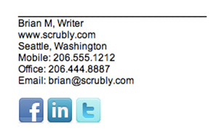
E-mail design
Links:
Graphical links
Combination of an image and text explaining where the image points too. For example:
Key elements such as links to website, and especially the main Call-to-Action (CTA) (source: Econsultancy)
But, some marketers suggest that if an icon represents well an action, then it does not need to be accompanied by text. For example:
Logo leading to homepage of website
Audio buttons with the icon of speaker
Thumbnails/images of products
Notes:
Call to Action = Get readers to perform a task

Slide 17
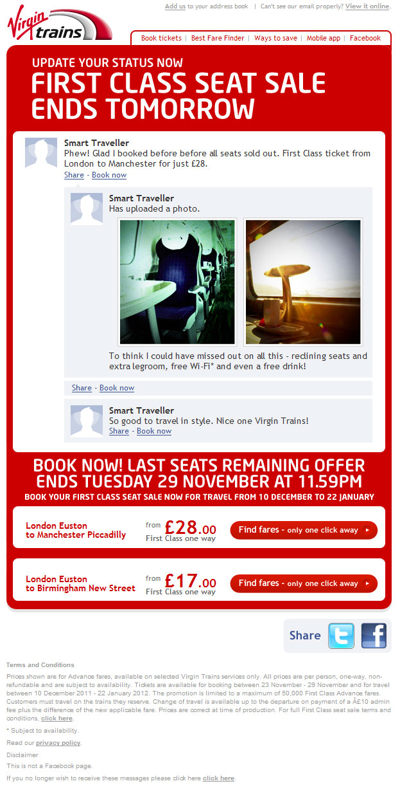
E-mail design
Top-left corner
First thing people see when opening an email is the top-left corner
How do we design that corner?
Logo/Name of business
Main headline
Images
They should be small enough to fit some text to encourage people to scroll
Call-To-Action (CTA) (e.g., read more on the blog, download the app, etc.)
Navigation links (e.g. TOC)
Try to fit them in that corner if users have to a lot of content to view; or if they have to visit the website
https://mailchimp.com/email-design-guide/
BACK
Notes:
Usually, people read emails on mobile devices to sort out: what to open now, save for later, or delete immediately
If it is useful in a mobile context, it will be opened immediately or saved later in the mobile. For example, a coupon that they can show in a store to receive discount
If it is not useful in a mobile context, or require typing on keyboard for online order process, then it won’t be opened in the mobile
See how Amazon and John Lewis take advantage of the top-left corner from Amazon and John Lewis

Slide 18
E-mail Content
In general:
An email is effective when it generates an immediate action or move people closer to that action (e.g. purchase decision). So, emails should probe people to action –as desired by the senders-.
Type of Content:
News, Events, Announcements, Promotions
Tips and Advice: Especially, before buying a product, there may be a need for research, facts and expertise. For example, advice about the purchase of video camera car, computer, mobile etc.
Instructions and directions: how to use best the products or services after sale

Slide 19
E-mail Content
Valuable offers:
They help to overcome purchase hesitation
Give different offers and present them differently according to customer profile. For example:
save money.
exclusive preview or a product which is not available to the general public.
Coupons with customers’ name on which can be: printed out; shown in a mobile phone for in-store redemption; linked to an item in an online commercial website. The “personalised” offer sometimes is placed at the bottom of the page rather at the top of it! Why?
Notes:
Check how Amazon promotes offers
Check how Fortnum and Mason promotes offers

Slide 20
E-mail Content
Writing a call-to-action (CTA):
Begin with a verb that describes the action, such as: visit, call, download, read, print, buy
Then, to make clear what you want them to do, combine the action-verbs with:
Links to do an immediate purchase
Specific instructions. For example:
Scroll done for a valuable coupon
Print this email to get a 10% discount
Share this email with a friend
Mobile friendly actions
Multiple or single actions?
Notes:
“Click here” or “Call us” in most cases are not enough (although Amazon does it sometimes!)
You have to explain why you want them to click or call you

Slide 21
E-mail Content
Social media aspects:
Use basic media features to promote the social media content to your email subscribers
Include a Facebook icon leading to your Facebook business page
Use advanced social media features so your social media followers can view your email without receiving them in an email box.
Email marketing provider tools can send the emails on Facebook wall and Twitter pages, as well as your subscribers’ Inbox.
In this way it is possible to publish the email content in different media but as part of the same campaign.
(source: MailChimp)
Notes:
E-mails can be shared, liked in Facebook, tweeted, rated and reviewed

Slide 22
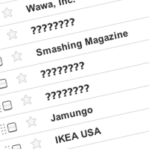
E-mail Content
“From” line:
“Your from line is your branding in the inbox. It sparks instant recognition of your business. And since it’s the very first thing subscribers see, it may be the biggest factor in getting your emails opened”. (source: Aweber Communications)
Create familiar ‘from’ lines to avoid spam complaints, even if you have people explicitly signed up to your email list.
Acronyms
Be consistent and do not change the ‘from’ line (at least do not change it often

Slide 23
E-mail Content
“Subject” line:
A well-thought out ‘subject’ line is another factor of getting the emails opened
General advice:
Describe the immediate benefit of opening the email with the fewest words as possible
Subject lines get cut-off after 40-50 characters
Test one subject line against another with two different samples from your email list
BACK
Notes:
email marketing provider can test the subject lines quite easily

Slide 24
Output of E-mail campaign
How your email marketing campaign was received
Email marketing provider software can show a report with bounced and blocked emails
Two types
Hard bounce: email address does not exist
In this case you should:
Contact your subscribers
Delete email from email-list
Soft bounce: email bounces because it is temporarily undeliverable (e.g. full Inbox) or it is blocked permanently
In this case you should check your email report
If there are 3 or more continuous soft bounces, then treated as a hard bounce
If there are irregular soft bounces, try again at a different day
Notes:
Hard bounce: wrong email or it has been changed

Slide 25
Output of E-mail campaign
Email marketing provider tools can provide a report which shows whether the sender opened or clicked on your email
Opened email: Recipient enabled the images in the email to display or clicked a link on the email
An email is not considered opened unless recipients have clicked or enabled images.
A ‘not opened email’ means usually recipients are not interested enough to do these actions.
But, the recipient may have scanned through them without taking a further action

Slide 26
Output of E-mail campaign
How your email marketing campaign was received
Email reports of email marketing provider software (EMPS) can track and show:
Who clicked on which link and how many people clicked on each link.
If people click to view your website, watch a video, download information, then this means that they are engaging with the content
So, leave some content out of your email and create links to it instead. Clicking in an email means interest.
BACK

Slide 27
Final remarks
Avoiding SPAM - Guidelines:
Do not send your subscribers email they have not asked for
Remind people, at the bottom of the email (i.e. footer), how they got on your list
Ask them to add you at their address book (at pre-header)
Protect your email list and don’t give it to someone else
Give the opportunity to the recipient not to receive any more emails from you, or unsubscribe.
Asking permission
Implied permission: Someone gives you his/her business card. Send this person an email to confirm that you have added him in your emailing list. Include a link along the lines: “If you don’t want to be in our email list anymore click here to unsubscribe”
Explicit permission: A box in the end of a form which says: “Please send me more news about future products, events etc.” It is the standard kind of permission and the one recommended by most marketers.
Confirmed permission: Someone is sending you an email to join your list and you are sending him back a confirmed message.
Collect email addresses
Notes:
Good examples of companies with anti-spam elements in their emails: Google email, Banana Republic, John Lewis
Source: http://kb.mailchimp.com/article/avoiding-the-spam-filters/

Slide 28
Useful Addresses
Design, content and general information
https://mailchimp.com/resources/email-design-guide/
http://www.mailingmanager.co.uk/blog/how-to-create-an-engaging-promotional-offer
http://www.campaignmonitor.com/guides/why-email/types/
https://help.campaignmonitor.com/bounced-email-types

Slide 29
Useful Addresses
Sources for email communication regulations and anti-spam
https://ico.org.uk/for-organisations/guide-to-pecr/
http://www.legislation.gov.uk/uksi/2003/2426/regulation/22/made (amendments 2016)
http://kb.mailchimp.com/delivery/spam-filters/about-spam-filters
http://kb.mailchimp.com/accounts/compliance-tips/terms-of-use-and-anti-spam-requirements (‘What am I responsible for’)

Slide 30
Next week
“Email marketing” is the last new topic we introduce in this module.
Next week (week 12) is the last week of the semester.
We will go through a summary of the topics we discussed in this module and you will have time to ask questions on the coursework that is due on Wednesday 13/04/2022

